Slide 1

MARKETING & RETAIL ANALYSIS
MILESTONE 1
Angela Jose
PGDDSBA – Aug 2022- Batch B

Slide 2
Table of Content
Agenda & Executive Summary of the data
Executive Summary & Problem statement
Data Dictionary
About Data
Exploratory Analysis and Inferences
Univariate Analysis : Skewness, Kurtosis, Boxplot, Distplot
Bivariate Analysis: Sales vs Various Parameters – Status vs Sales, Deal size vs Sales, Product line vs Sales, Country vs Sales, Customer vs Sales, City vs Sales, Ordered quantity vs Sales, MSRP vs Sales, Days since last order vs Sales, price each item vs Sales
Multivariate Analysis: Heatmap, pair plot
Time series of data: Mean and sum of Yearly, Quarterly, Monthly and Weekly data
Tableau representation of Yearly, Quarterly, Monthly and Weekly data of Sales
Inference from EDA
Customer Segmentation using RFM analysis
Tools used
Parameters used and assumptions made
Workflow image- KNIME
Output table head
Inferences from RFM Analysis and identified segments
Best customers Loyal customers
Customers are on the verge of churning Lost customers
Inference

Slide 3
Executive Summary & Problem statement
Executive Summary:
This project aims to find the underlying buying patterns of the customers of an automobile part manufacturer based on the past 3 years of the Company's transaction data and hence recommend customized marketing strategies for different segments of customers.
Auto Sales Data: Sales_Data.xlsx
Problem Statement:
An automobile parts manufacturing company has collected data of transactions for 3 years. They do not have any in-house data science team, thus they have hired you as their consultant. Your job is to use your magical data science skills to provide them with suitable insights about their data and their customers.

Slide 4
Data Dictionary
ODERNUMBER : | Order Number | CUSTOMERNAME : | customer
QUANTITYORDERED : | Quantity ordered | PHONE : | Phone of the customer
PRICEEACH : | Price of Each item | ADDRESSLINE1 : | Address of customer
ORDERLINENUMBER : | order line | CITY : | City of customer
SALES : | Sales amount | POSTALCODE : | Postal Code of customer
ORDERDATE : | Order Date | COUNTRY : | Country customer
DAYS_SINCE_LASTORDER : | Days_ Since_Lastorder | CONTACTLASTNAME : | Contact person customer
STATUS : | Status of order like Shipped or not | CONTACTFIRSTNAME : | Contact person customer
PRODUCTLINE : | Product line – CATEGORY | DEALSIZE : | Size of the deal based on Quantity and Item Price
MSRP : | Manufacturer's Suggested Retail Price
PRODUCTCODE : | Code of Product

Slide 5
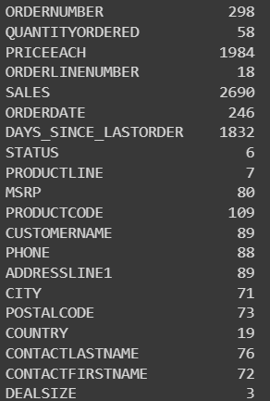
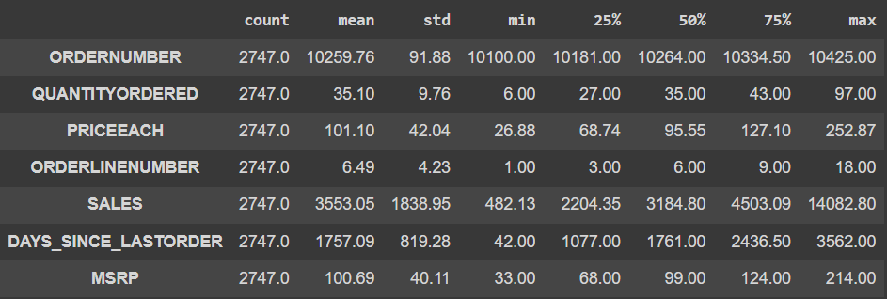
About Data
Data has 2747 rows and 20 columns
The data has 1 datetime , 2 float, 5 integers and 12 object data types.
Data is clean it has no duplicate or null values
Data parameters: Quantity ordered, Price each, Sales and MSRP has outliers.
Manufacturing company has 89 Customers across 19 countries dealing with 7 product line
Company has 109 unique product code
Having 3 Deal size : Small, Medium and Large
Quantity ordered in the range 6 to 97
Individual price of products varies between 26 to 252
Summary of the status of the shipment:
Summary of data unique value
Summary of data description
Shipped | 2541
Cancelled | 60
Resolved | 47
On Hold | 44
In Process | 41
Disputed | 14

Slide 6
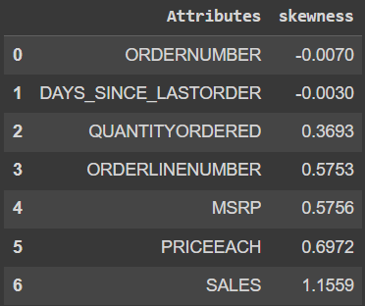
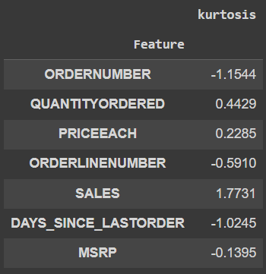
Exploratory Analysis and Inferences
Univariate Analysis
Skewness
Kurtosis
Skewness
Skewness-measure of symmetry of data
Skewness-‘Day_since_lastorder’ has negative skewness while other parameters has positive skewness which means most of the parameters value are bent towards the lower side. Where Sales has the highest positive skew 1.155.
Skewness between -0.5 and 0.5 is symmetrical.
Kurtosis
Kurtosis-Tailedness of a distribution
Kurtosis- ‘Day_since_lastorder’ and ‘MSRP’ has negative kurtosis and rest other parameters has positive kurtosis.
High kurtosis indicate having heavy tails and more outliers, while data sets with low kurtosis tend to have light tails and fewer outliers.
A distribution with a negative kurtosis value indicates that the distribution has lighter tails than the normal distribution.

Slide 7
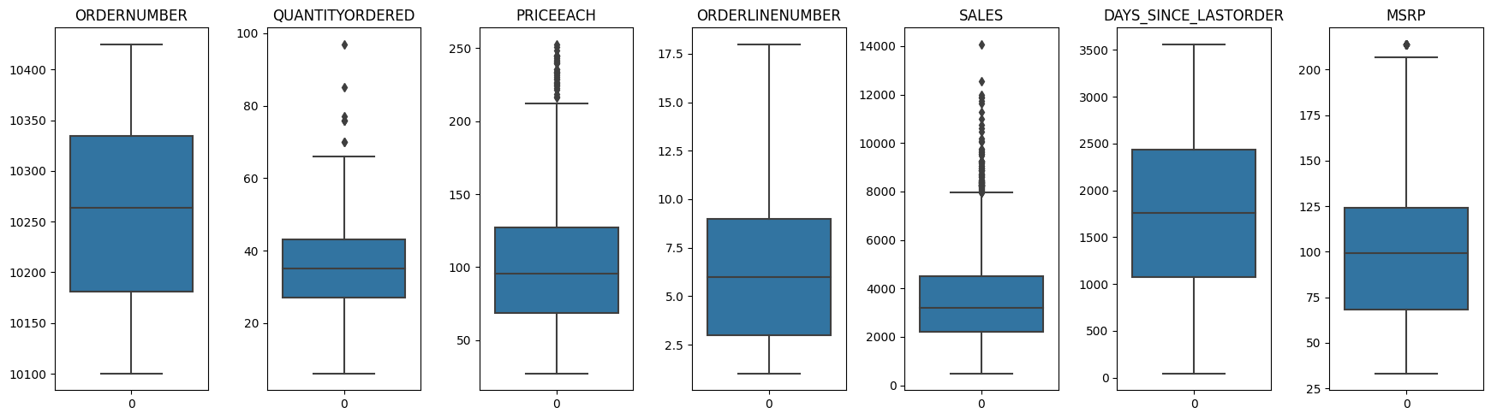
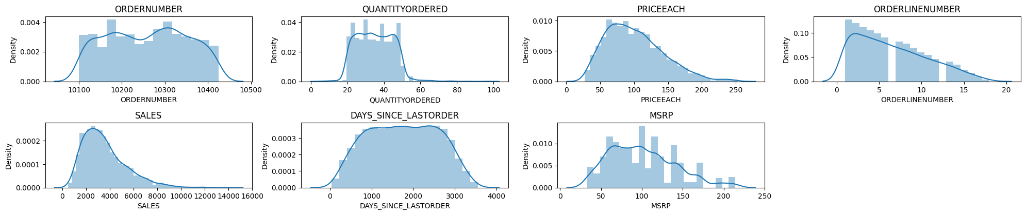
Exploratory Analysis and Inferences
Univariate Analysis
Boxplot
Data parameters: Quantity ordered, Price each, Sales and MSRP has outliers.
Where Sales has most value of outliers and MSRP has least outlier.
DISTPLOT
All parameters has a normal distribution where sales has most positive skewed data.
Also parameter MSRP has the most peaks across the distribution

Slide 8
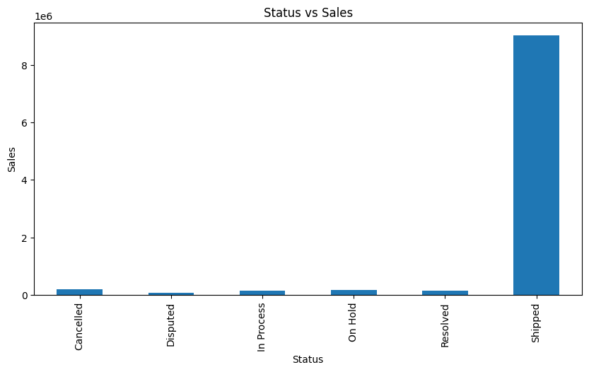
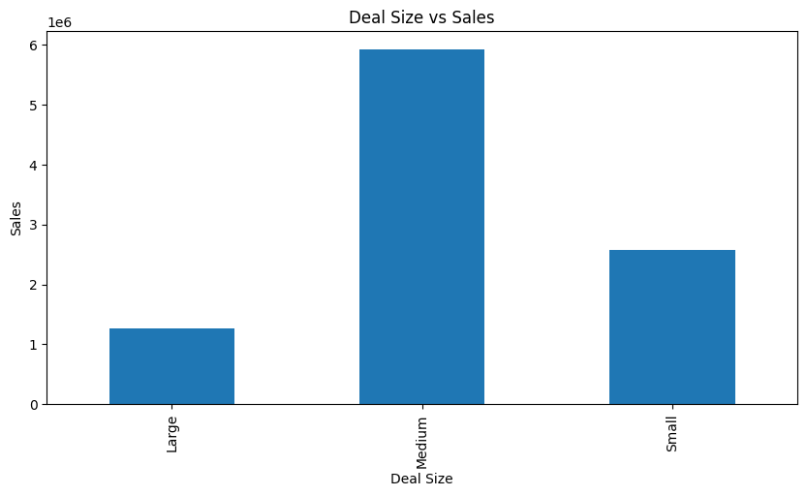
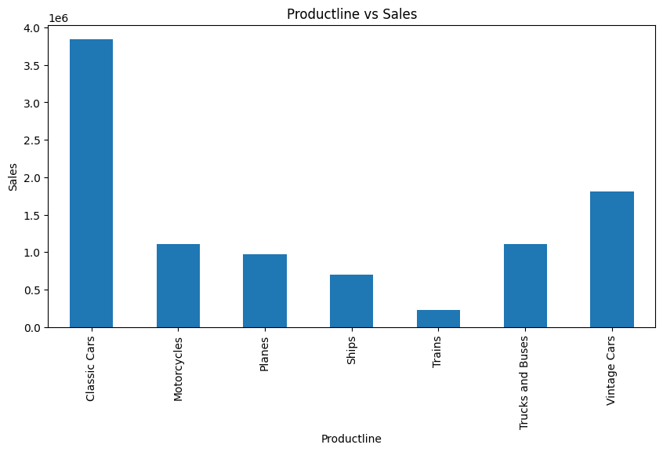
Exploratory Analysis and Inferences
BIVARIATE Analysis: SALES VS VARIOUS PARAMETERS
Status vs Sales:
92% products are shipped and rest 8 % of the product has any 1 of the following status : cancelled, disputed, in process, on hold or resolved
Deal size vs Sales:
61% of deal has medium size, 26% small and 13% large size deal. Most of the deals are medium sized.
Product Line vs Sales:
Most sold parts are of classic car followed by Vintage cars and other categories

Slide 9
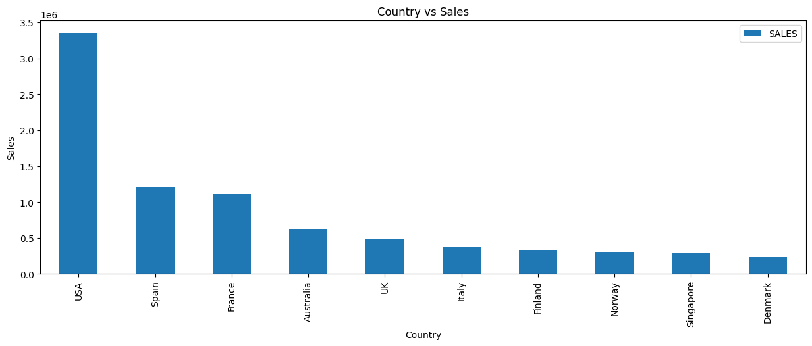
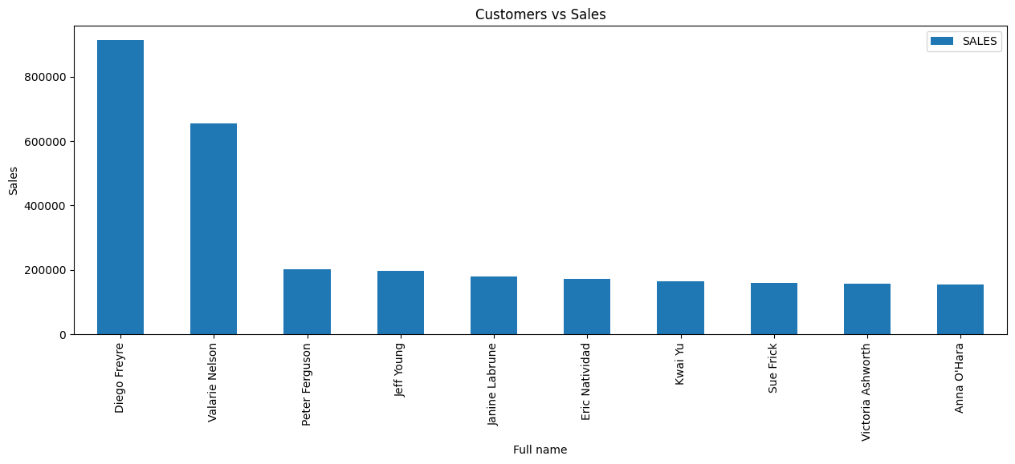
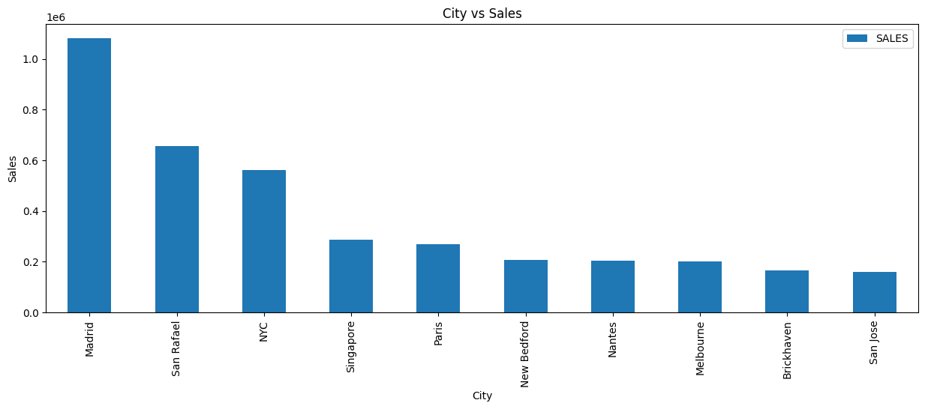
Exploratory Analysis and Inferences
BIVARIATE Analysis: SALES VS VARIOUS PARAMETERS
COUNTRY vs Sales:
USA has the highest sales followed by Spain, France, Australia and UK in the top 5
CUSTOMER vs Sales:
Top customers having most sales are mainly Diego Freye and Valarie Nelson
CITY VS sales:
Madrid has the highest sales in city category followe

Slide 10
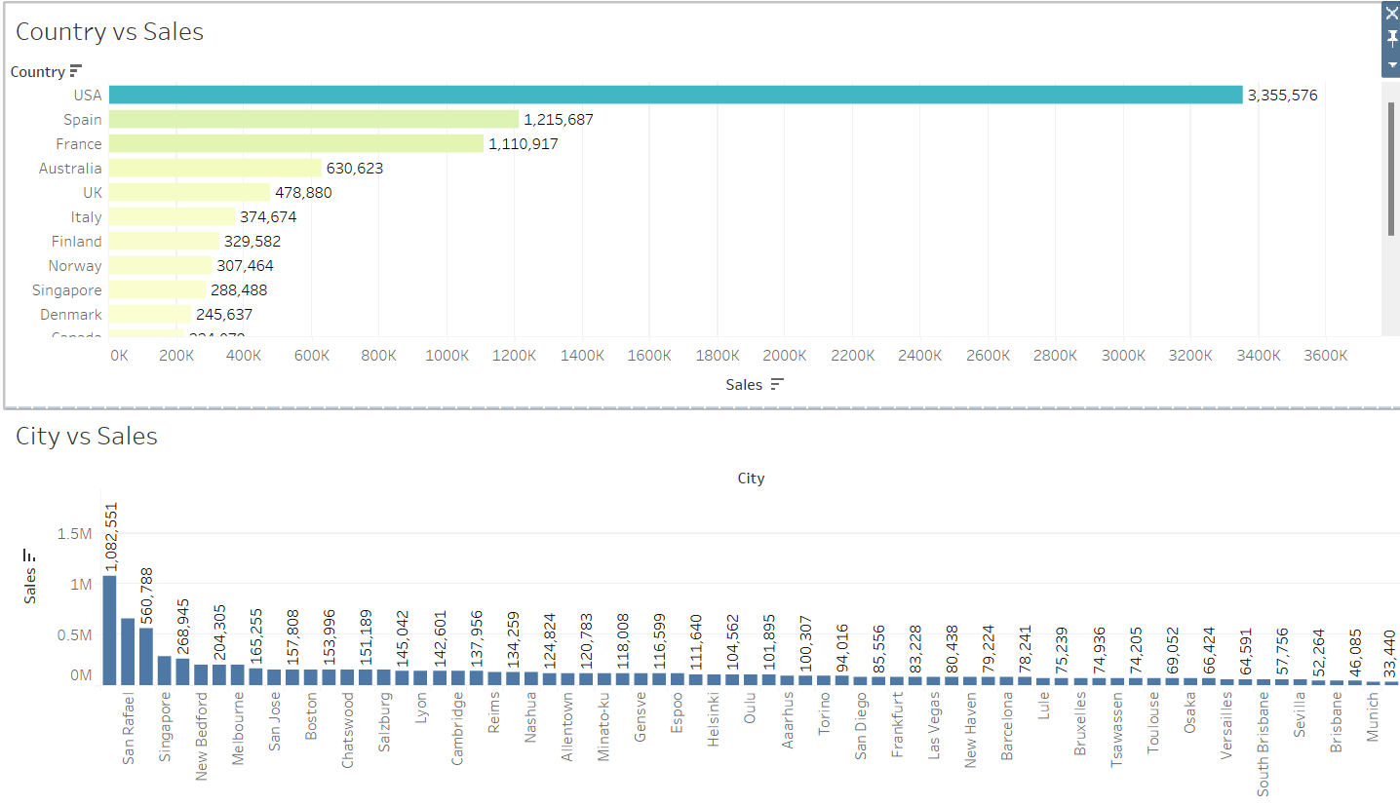
Exploratory Analysis and Inferences
BIVARIATE Analysis: SALES VS VARIOUS PARAMETERS

Slide 11
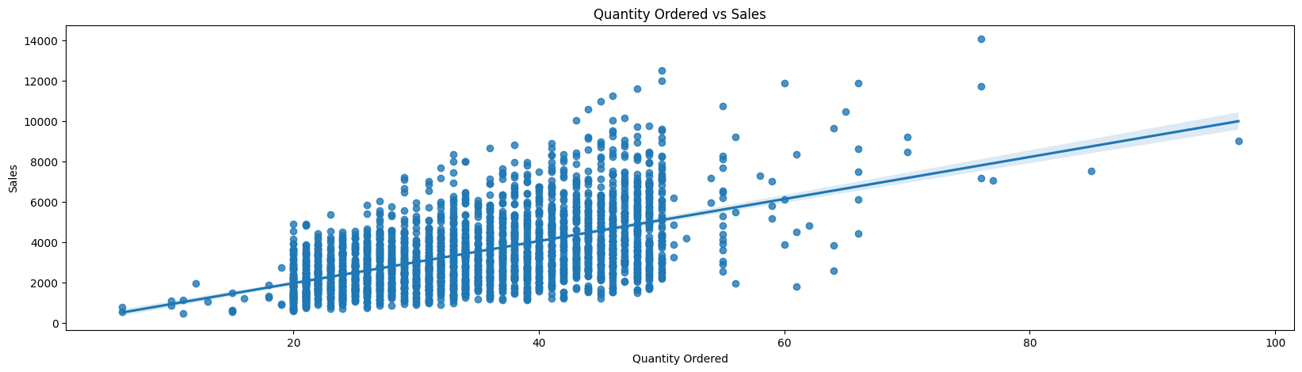
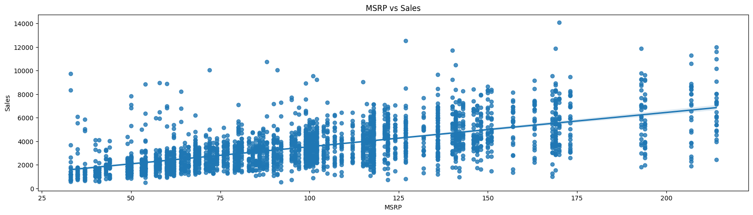
Exploratory Analysis and Inferences
BIVARIATE Analysis
Ordered Quantity vs Sales
It has a positive correlation
Most of the ordered product are within 20 to 50 range
Ordered quantity decreases with increase in sale
MSRP vs Sales
It has a positive correlation
Products of MSRP between 25 and 175 where most sold.

Slide 12
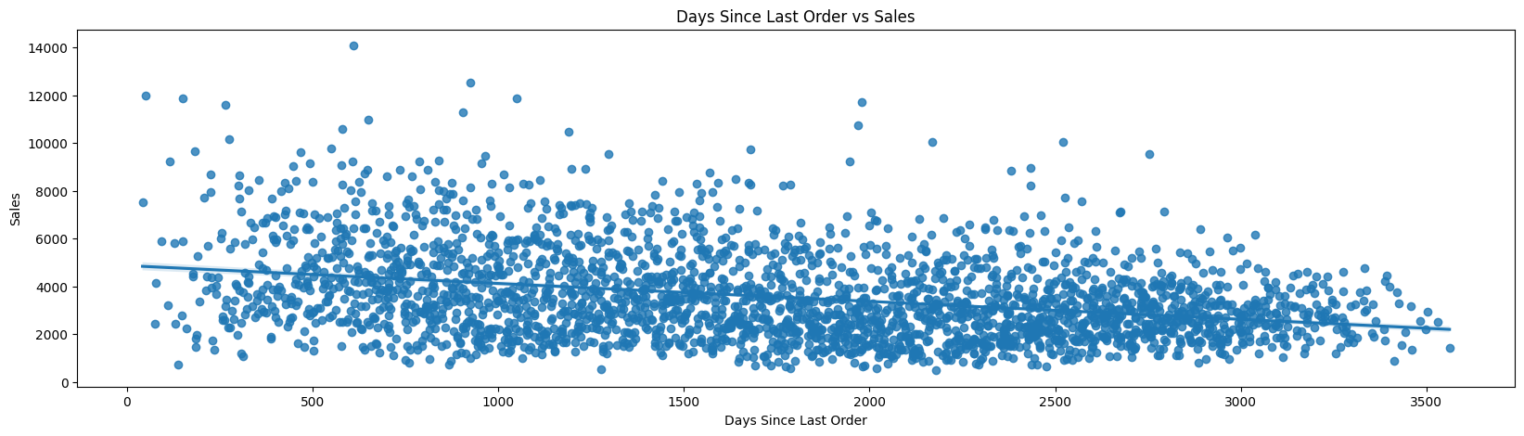
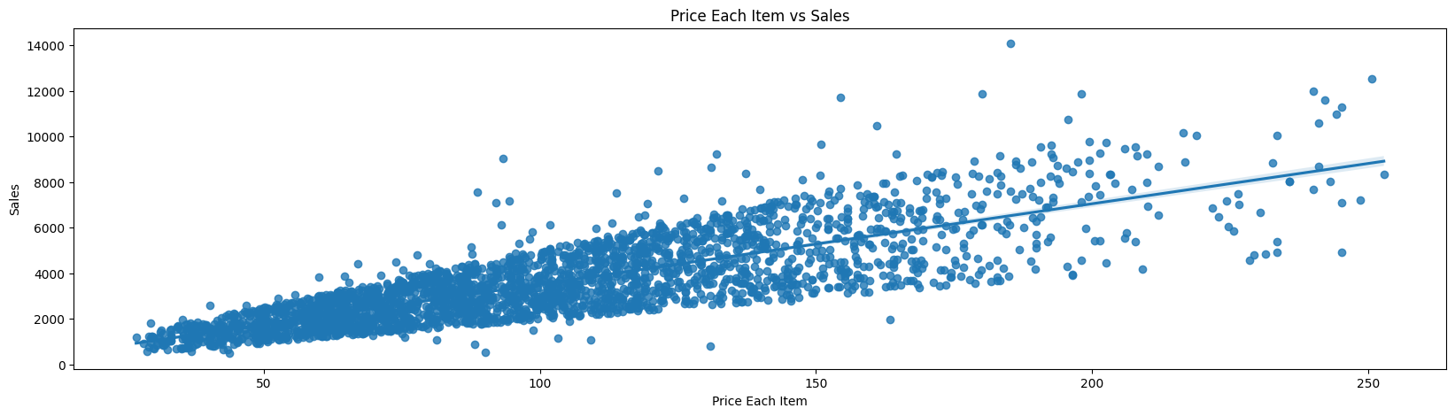
Exploratory Analysis and Inferences
BIVARIATE Analysis
Days since las order vs Sales
It has a negative correlation
Sales decreases as number of day since last order increases.
Price each item vs Sales
It has a positive correlation
As price of each item increases sales increase. As price is related to sale amount.
However sales is comparately less when price of items increases.

Slide 13
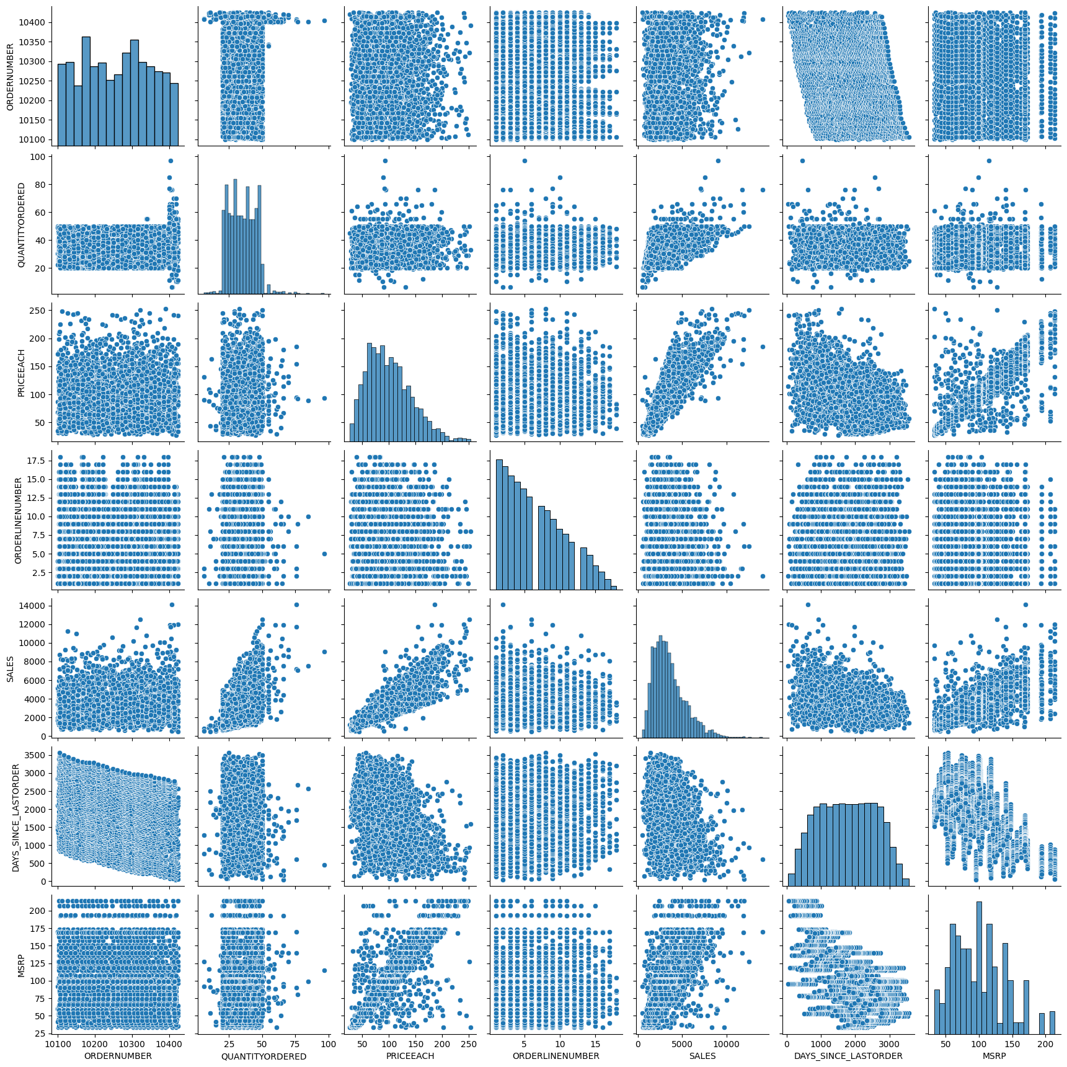
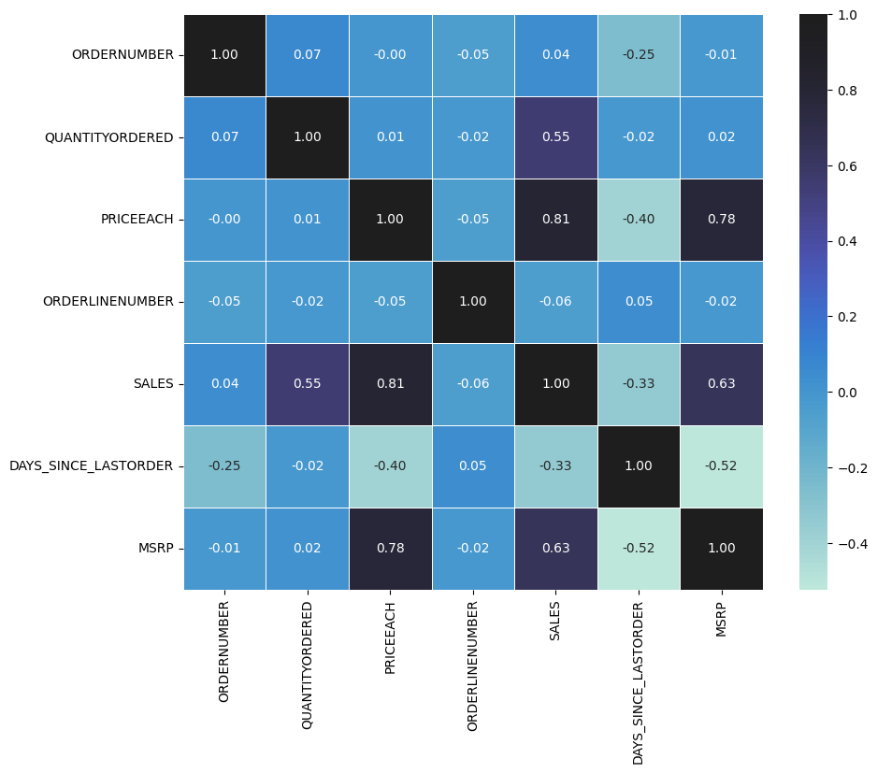
Exploratory Analysis and Inferences
multivariate Analysis
Heatmap
Variables ‘Sales’ and ‘Price each’ have highest positive Correlation(0.81)
Correlation exist between Quantity Ordered, Sales, MSRP and PriceEach
Variables ‘Days_since_lastorder’ and ‘MSRP’ have highest negative Correlation(-0.52)
Pairplot
Most features are normal distributed
It has varying kurtosis

Slide 14
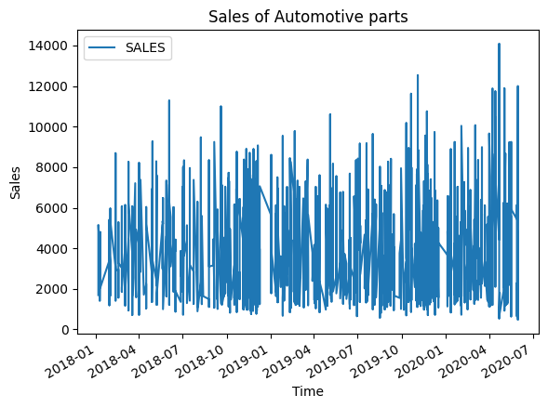
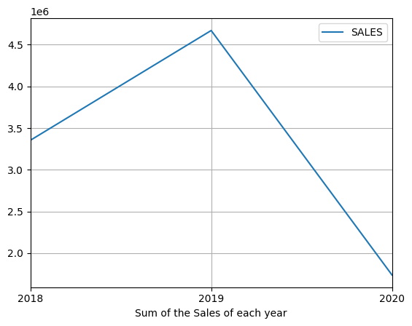
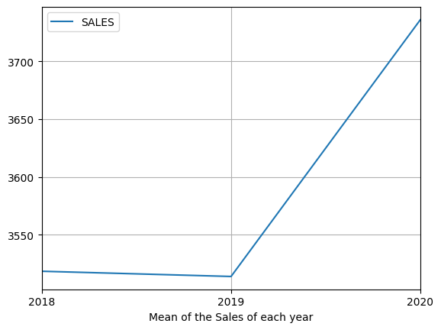
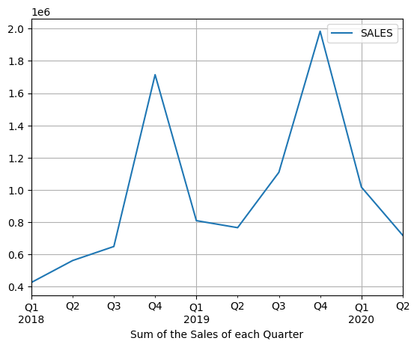
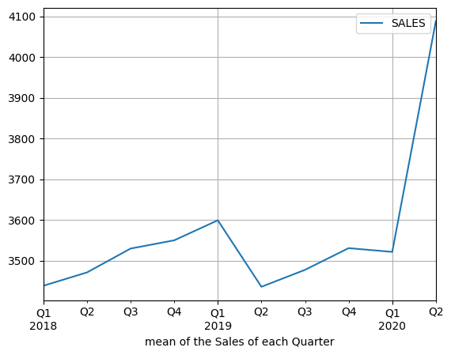
Exploratory Analysis and Inferences
Time series of DATA
Yearly Sales : Sum and mean of Sales
2019 has the highest in comparison to 2018, since it has partial data
Comparing mean sales 2020 has the highest sales
Quarterly Sales : Sum and mean of Sales
Q4 of 2019 has the highest sales sum
Q2 of 2020 has the highest mean sale

Slide 15
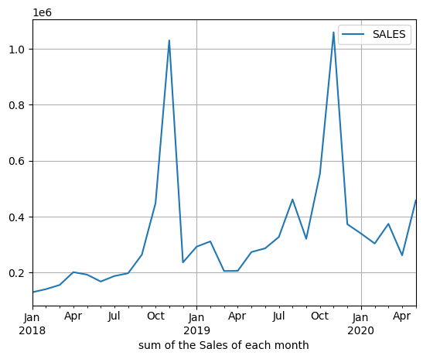
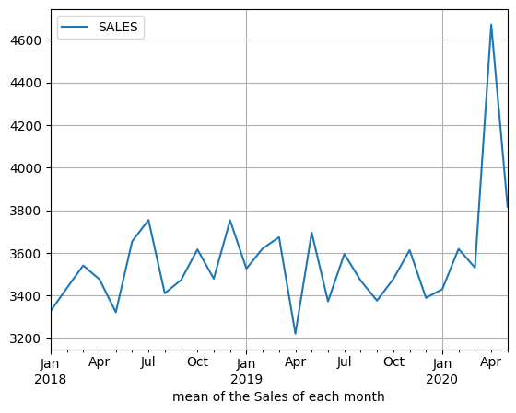
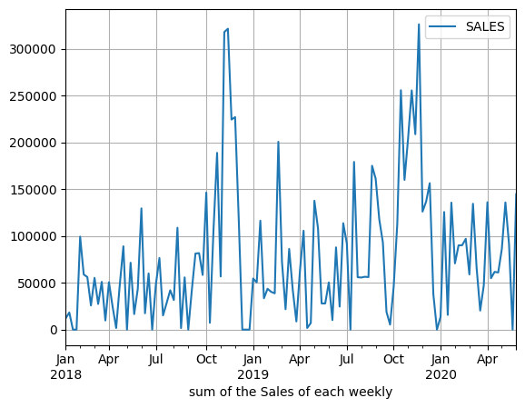
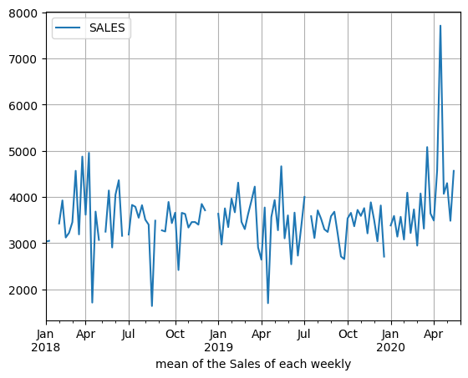
Exploratory Analysis and Inferences
Time series of DATA
Monthly Sales : Sum and mean of Sales
Usually Nov has the highest sum of sale
Comparing the mean sales, Apr 2020 had the highest mean sales in Quarter 2
Weekly Sales : Sum and mean of Sales
The pattern of sum and mean sales is similar to monthly sales
We can identify the weeks with most amount of sales in the month of november as well as the week with most mean sales Apr 2020 in comparison with other week

Slide 16
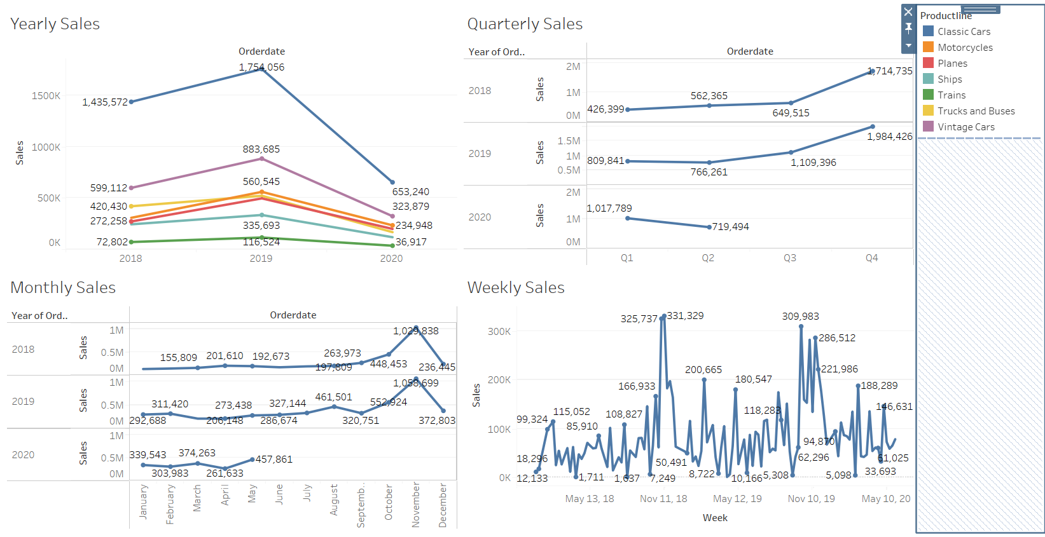
Exploratory Analysis and Inferences
Yearly Sales
Classic cars parts had the highest sale followed by vintage cars .Trains parts had the least sales
Quarterly and Monthly Sales
Since 2020 data is partial till May 2020 we cannot predict the sum of sales trend to 2020.
Based on quarterly data observed that Quarter 4 has the highest sales which is most because during November the sale of automotive parts are high. Observed this trend in both 2018 and 2019. 2019 had the highest sales during November
Weekly Sales
Weekly between Nov 4 to 20 has the highest sales during 2018 and 2019

Slide 17
INFERENCE FROM EDA
‘Day_since_lastorder’ has negative skewness while other parameters has positive skewness which means most of the parameters value are bent towards the lower side. Where Sales has the highest positive skew 1.155. Most of the parameters except sales are fairly symmetric
Kurtosis- ‘Day_since_lastorder’ and ‘MSRP’ has negative kurtosis and rest other parameters has positive kurtosis.
Data parameters: Quantity ordered, Price each, Sales and MSRP has outliers.
92% products are shipped. Most of the deals are medium sized. Most sold parts are of classic car followed by Vintage cars
USA has the highest sales followed by Spain, France, Australia and UK. Top customers having most sales are mainly Diego Freye and Valarie Nelson
Ordered quantity, MSRP , price each has a positive regression with sales whereas days since last order has negative relation
Correlation exist between Quantity Ordered, Sales, MSRP and PriceEach
Comparing mean sales 2020 has the highest sales
Based on quarterly data observed that Quarter 4 has the highest sales which is most because during November the sale of automotive parts are high. Observed this trend in both 2018 and 2019. 2019 had the highest sales during November
Weekly between Nov 4 to 20 has the highest sales during 2018 and 2019

Slide 18
Customer Segmentation using RFM analysis
Which tool used?
Tools used for RFM segmentation KNIME and Excel.
What all parameters used and assumptions made
Parameters used:
QUANTITY ORDERED , PRICEEACH, SALES, ORDERDATE, ORDERNUMBER, CUSTOMERNAME
Assumption made:
Recency is calculated by Max(Order date)- Order date
All sales and MSRP values are in same unit
Monetary parameter calculated by QUANTITY ORDERED * PRICEEACH
All 89 customer name are unique
Frequency calculated group by CUSTOMERNAME by the order number
3 Bins created with percentile : 0 ,0.25,0.75, 100
0- 0.25 – Recency (H), Frequency (L), Monetary(L)
0.25-0.75 – Recency (M), Frequency (M), Monetary(M)
0.75- 1 – Recency (L), Frequency (H), Monetary(H)

Slide 19
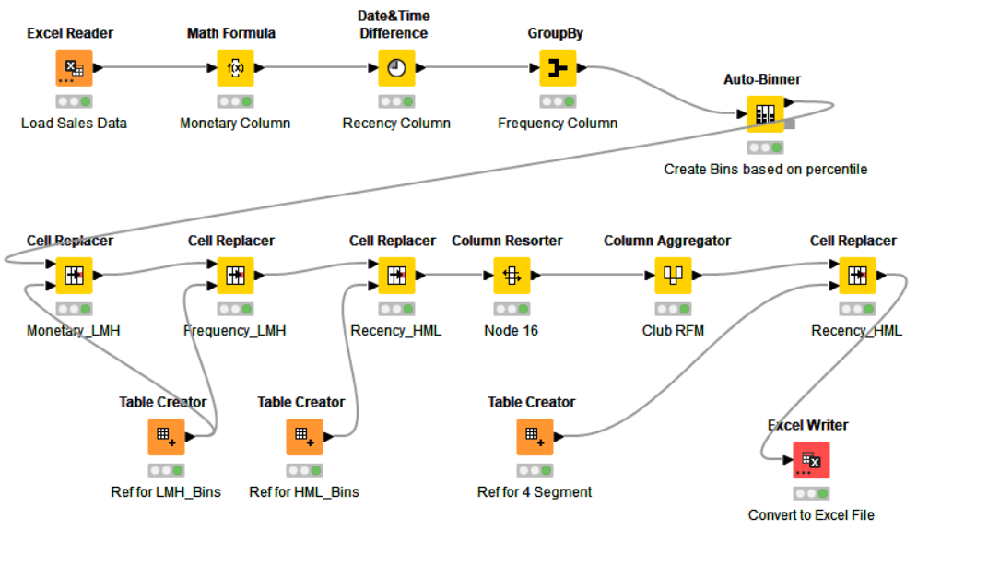
Customer Segmentation using RFM analysis
WORKFLOW IMAGE -knime

Slide 20
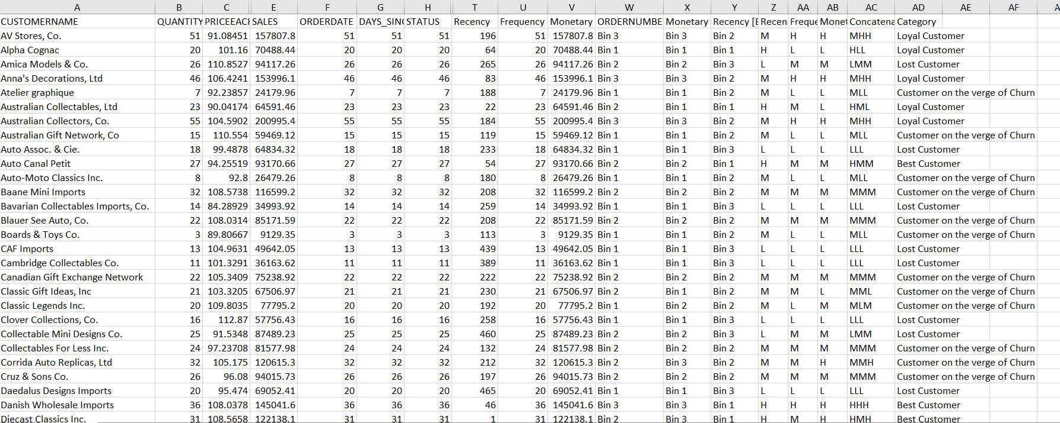
Customer Segmentation using RFM analysis
Output table head

Slide 21
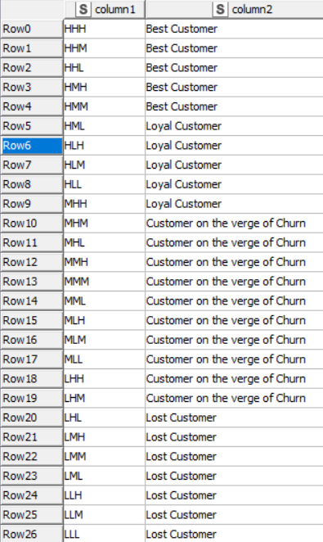
Customer Segmentation using RFM analysis
4 segmentation-knime
Based the table created 4 segments :
Best
Loyal
Customers on the verge of Churn
Lost.
The best customers has the highest Recency and high or medium Frequency and Monetary.

Slide 22
Inferences from RFM Analysis and identified segments
SI. No | Best customers | Loyal customers
1 | Danish Wholesale Imports | Alpha Cognac
2 | Euro Shopping Channel | Australian Collectables, Ltd
3 | L'ordine Souveniers | Lyon Souveniers
4 | La Rochelle Gifts | Mini Caravy
5 | Mini Gifts Distributors Ltd. | AV Stores, Co.

Slide 23
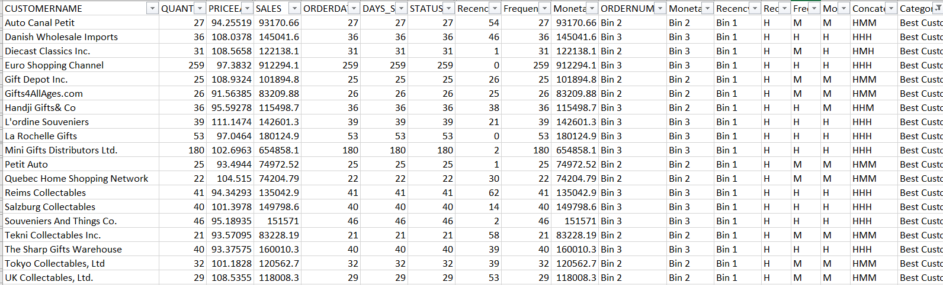
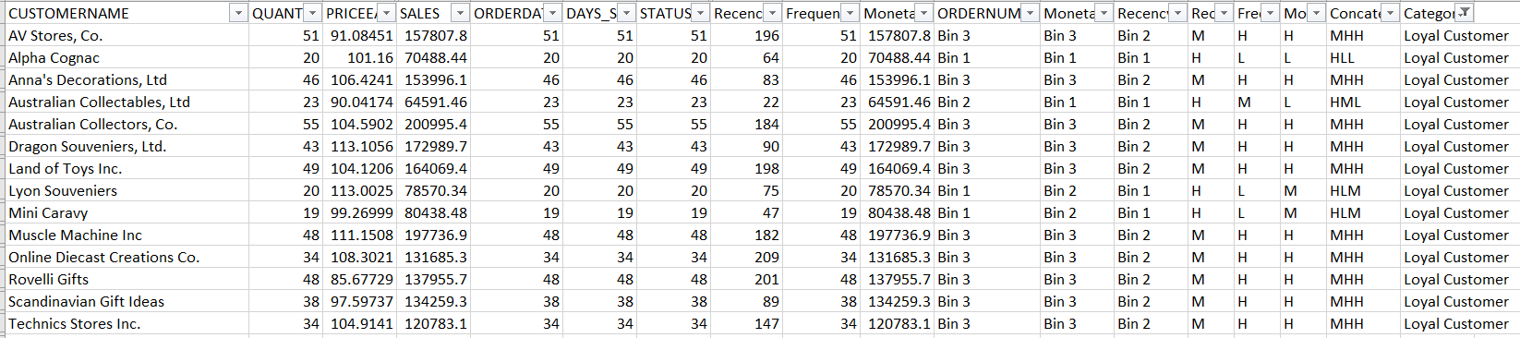
Inferences from RFM Analysis and identified segments
Inference
Best Customers
These customers generate the maximum revenue for the company
Recency is the best parameter used for classification
Loyal customers
These customers are second best
They have recency between H and M
Also fairly high Monetary and Frequency values
With proper steps they can be converted to ‘Best’ category

Slide 24
Inferences from RFM Analysis and identified segments
SI. No | Customers are on the verge of churning | Lost customers
1 | Marseille Mini Autos | Iberia Gift Imports, Corp.
2 | Mini Classics | Online Mini Collectables
3 | Motor Mint Distributors Inc. | Osaka Souveniers Co.
4 | Oulu Toy Supplies, Inc. | Signal Collectibles Ltd.
5 | Saveley & Henriot, Co. | West Coast Collectables Co.

Slide 25
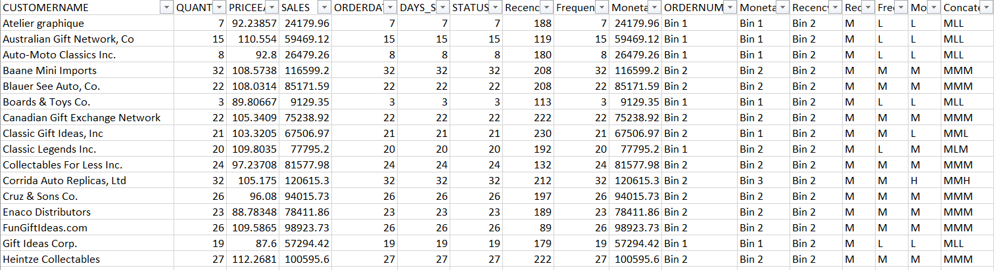
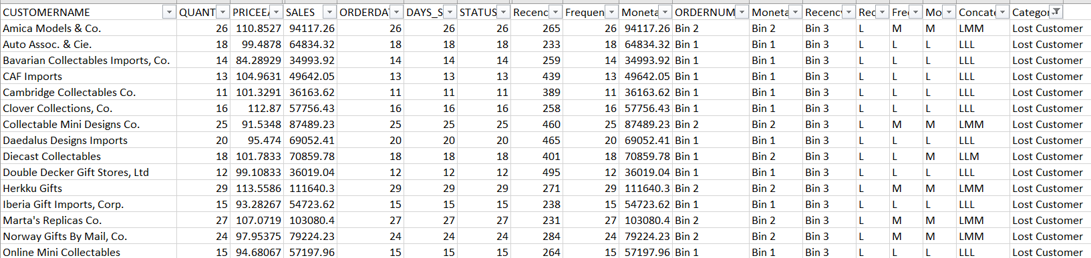
Inferences from RFM Analysis and identified segments
Inference
Customers are on the verge of churning
With proper steps they can be converted to ‘Loyal’ or ‘Best’ category
These customers have less Recency
Properly targeting them and increase the chance of them visit store will increase sales
If no steps are taken they are most likely to leave the system
Lost customers
These customers have least Recency and less Frequency and Monetary value
They are most lost customers and they require too much work to bring them back to system or store.
It is advisable to leave them behind if cost of marketing is high

Slide 26
Inferences from RFM Analysis and identified segments
Inference
Using Recency, Frequency and Monetary parameters customers are segmented to Best , Loyal, on the verge of churning and lost customers.
Recency is the best feature followed by Frequency and Monetary
Customers with good recency is classified under best customers and those with low Recency and other parameters are classified as lost ones.
Loyal customers has fairly high Recency, Frequency and Monetary value which can be further increased easily
Best customers generate the maximum revenue whereas lost customers are not frequent users.
Customers on the verge of churning can be converted to loyal or best with proper marketing strategies
Lost customers are not useful is it not fruitful to spent money on them as they are most likely not returning
Customers on verge of churning can be saved and can be converted into a good buyer or keep them
Proper marketing strategies should be applied for specific categories so as to maximise sales

Slide 27
THANK YOU

